Slide 1
SOC 225:
Data and Society Labs

Slide 2
Week 2: Privacy Overview

Slide 3
Agenda
Lecture recap
In this lab: case study
Re-identification of Mass. Governor William Weld
Core skills today: data wrangling
Appendix: key sociology concepts
Appendix: key data science concepts
Appendix: key R functions and vocabularies

Slide 4
Lecture this week
Big questions in privacy for individuals
Who wo we want privacy from
Who do we trust with what information
Implications for individual and society
GDPR right to be forgotten
What do Americans think about privacy
Workplace surveillance
Amazon warehouse workers, truckers

Slide 5
Lecture this week
Privacy and Presentation
Framework: the presentation of self in everyday life (Goffman)
Case studies in modern privacy and trust
Apple code lock
Target and pregnancy
Opting out of big data
Airbnb and trust

Slide 6
This lab: Case study
Re-identification of Mass. Governor William Weld
Public voter data
Name
ZIP code
Sex
Birth date
Anonymous insurance data (released under assurance of anonymity from Gov. Weld)
ZIP code
Sex
Birth date
Prescription
Diagnosis
Notes:
https://arstechnica.com/tech-policy/2009/09/your-secrets-live-online-in-databases-of-ruin/

Slide 7
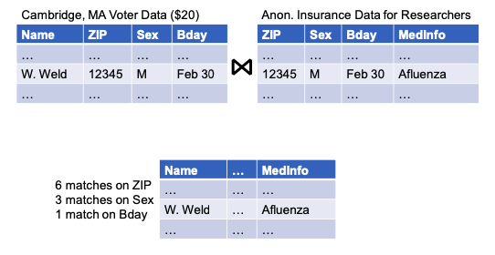
This lab: Case study
Implicit disclosure through merging/joining data tables
Notes:
CSE 414: Database management

Slide 8
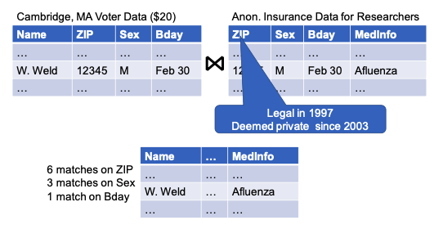
This lab: Case study
Implicit disclosure through merging/joining data tables

Slide 9
This lab: Case study
Sensitive information
Personal identifiers
Names
Student ID
Social security number
License number
Protected data (for legal and/or ethical reasons)
Academic records (FERPA)
Protected Health information (HIPAA)
User Web Data (GDPR)
Passwords

Slide 10
Core skills today: data wrangling with tidyverse
Introduction and setup
tidyverse package
Data on using smartphone tracking to measure covid-19 exposure
Modify data frames
Summarize data frames
Create new variables
Notes:
Data wrangling: everything you have to do to a data set to get it ready for analysis
Two ways: base R; tidyverse
Managing and summarizing data

Slide 11
Appendix: key sociology concepts
Privacy: who, what, when
Individual and society
The presentation of self in online platforms
Workplace surveillance

Slide 12
Appendix: key data science concepts
Data anonymization
Sensitive information
Personal identifier
Protected data
Passwords

Slide 13
Appendix: key R functions and vocabularies
glimpse(): get a glimpse of your data.
tidyverse:
filter(): pick cases (rows) based on their values.
arrange(): change the ordering of rows.
select(): pick variables (columns) based their names and types.
summarize(): reduce multiple values down to a single summary.
group_by(): perform operations by group.
mutate(): add new variables that are functions of existing variables.
distinct(): select only distinct/unique rows from a data frame.
ifelse(): assign one object or another depending on whether the first argument, test, is TRUE or FALSE.
month(): get month component of a date-time (lubridate).
ggplot2:
ggplot(): initialize a ggplot object.
geom_histogram(): display the count with bars for continuous variables.
geom_bar(): display the count with bars for categorical variables.

